Slide 1
Literary Analysis: Beyond Response to Criticism
From Literature: Reading, Reacting, Writing

Slide 2
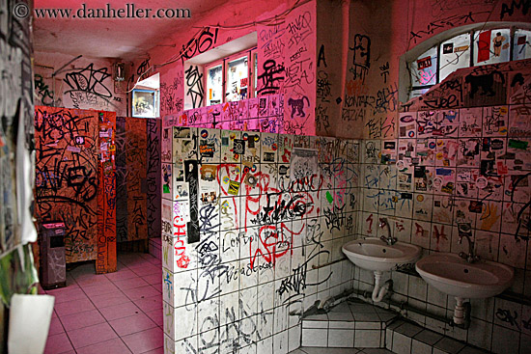
Literature
There are purposes for every piece of writing
Primary purpose: to help the author and the reader to make meaning from an experience, and to come to understand the world in a more complete and nuanced way

Slide 3
Imaginative Literature
Imaginative Literature
Begins with a writer’s need to convey a personal vision to readers.
Primary purpose is to present their unique view of experience, one that has significance beyond the moment
Not necessarily factual, but can use facts within story

Slide 4
Types of Literature
Imaginative
Genres
Fiction
Poetry
Drama
Keep in mind all cultures do not have the same understandings of genres within literature.

Slide 5
Literary Canon
Originally, accepted list of books that made up the Christian Bible
Now it denotes a group of works generally agreed upon by writers, teachers, and critics to be worth reading and studying.
The canon of a specific discipline (science, literature, farming – all have their own individual canons) is in a constant state of flux, rather than being set in stone, as used to be the case.

Slide 6
Changing Canons
The traditional literary canon (Homer, Plato, Dante, Chaucer, Shakespeare, Milton, etc.) leaves out great numbers of groups and writers
What groups do you see missing from the list above?

Slide 7
Interpretation of Literature
Interpret – you explore the meanings of a text
Is there one, single meaning, hidden within a text?
Or is it possible that there are many different meanings, all changing as each of us brings something new to the reading and interpretation of the text?

Slide 8
Interactive Reading Process
Meaning is created through the reader’s interaction with a text
Meaning is created partly by what is supplied by a work and partly by what is supplied by the reader

Slide 9
What’s Conveyed?
Facts
This is what allows the reader to follow the story
Factual details about the setting, the characters, etc.
Attitudes of the writer
Social, political, class, and gender
Assumptions about literary conventions
Are all poems supposed to rhyme?
Personal perspectives
This is what you bring to the text
What I bring to the text as a scholar, mother, wife, daughter, privileged white woman is going to be different in many ways from what you bring and how you see the world

Slide 10
Conversation
Reading literature is like having a conversation
The text speaks, then you reply
Because every reading of a literary work is actually an interpretation, it is a mistake to look for a single “correct” reading

Slide 11
“Stopping by Woods on a Snowy Evening”
Page 1159 in your text
What does it mean? How do you interpret it? What themes do you see in it?
Handout

Slide 12
One Rule!
While texts are open to interpretation, the interpretation must be defensible. You may contribute ideas based on your own perspectives and experiences, but you cannot ignore or contradict evidence in the text to suit your own biases.
As you read and reread a text, continue to question and reexamine your judgments.
The correct answer to “Why do you think that about the readings?” is NEVER “because I think it makes sense.”

Slide 13
Evaluating a Text
Evaluate = making a judgment
Analyze it – break it down into its parts
Begin with understanding the purpose of the text
Was it written for entertainment? Education? Satire? Enlightenment?

Slide 14
Road Map for Evaluating and Analyzing Literature (pgs. 12-14)
How do various literary elements function within a work?
Do the literary elements of a work interact to achieve a common goal?
Does the work reinforce or call into question your ideas about the world?
Is the work intellectually challenging?
Does it give you pleasure?

Slide 15
Literary Criticism: What is it and why do it?
Literary criticism is not the same thing as being critical of a piece of work. Literary criticism is writing by experts who describe, analyze, interpret, or evaluate a work of literature – not someone who reads a book and then declares that it’s terrible.
Lit crit is intended to further explicate and understand a text rather than condemn it.

Slide 16
What and Why?
To further understand a text, you might read what others have said about it (that’s literary criticism, and you will be doing that this semester, btw)
As a reader, you might not understand the lens that an author has used in her construction of the text (and when we say “lens” we are speaking of their point of view, where they stand in the world, the larger contextual understanding of the author and her life and times).
See Appendix A of your text
The lens(es) used by an author might have something to do with an intellectual or philosophical movement
Darwinism
Marxism
Naturalism
Structuralism
Feminism

Slide 17
Before you can speak, you must first read.
Pages 17-22 discuss active reading – I suggest that you review these pages before you begin reading for homework purposes

Slide 18
Purpose
Writing to respond
Writing to interpret
Writing to evaluate

Slide 19
From Beginning to End of the Process
Pages 22-36 discuss the steps and make suggestions about the process of beginning, ending, and revising. Please be familiar with these steps. We will use them throughout the semester.

Slide 20
Checklist: Conventions
Present tense verbs
Unnecessary plot summary
Use literary terms correctly
Underline titles of novels and plays
Authors get their full name the first time you reference them, after that, just the last name
Never use titles (Miss, Mr., Dr., etc.)

Slide 21
Reading and Writing About Fiction
Look at the plot of the story
Analyze the characters in the story
Identify the setting of the story
Examine the narrative point of view of the story
Analyze the style, tone, and language of the story
Focus on symbol, allegory, and myth
Identify the themes of the story

Slide 22
One last word...
What exactly do we mean by “analyze”?
With regards to literature, the act of analysis is literally the act of separating a whole into parts in order to understand that whole.
Any analysis of a literary work requires that the writer understand the intention (i.e., the theme) of the work and how that theme is revealed in the course of the work.
Think about what the talking heads on the news do after a big speech by the President, or after a play in sports. That is analysis.

