Slide 1
Audience and Voice

Slide 2
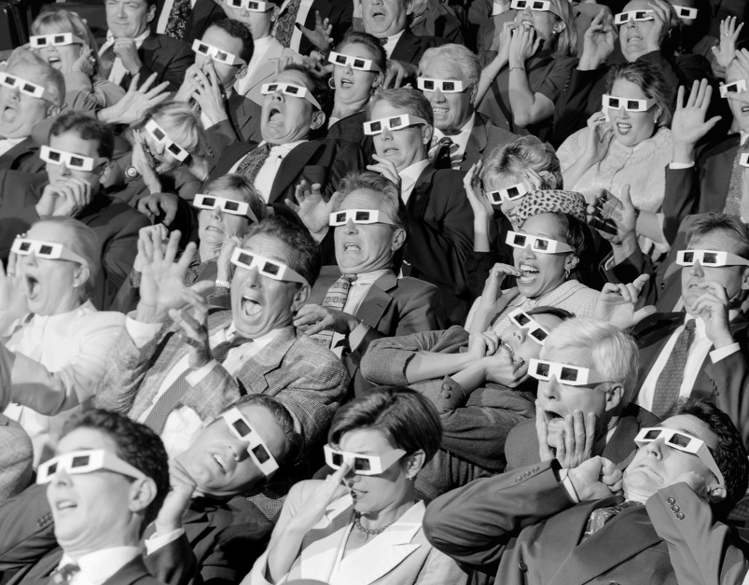
Definitions
Audience:
the people who see the work of a particular artist or read the work of a particular writer
Voice: The flip side of audience. This is the embodiment of the author, in the words she chooses.

Slide 3
Audience :: Voice
Depending on who your audience is, the author’s voice will change.
Imagine you have to tell your parents about a fight you had with your significant other. What details would you focus on? What details would you leave out?
Now imagine telling your best friend about the fight. How does that conversation differ?
This is consideration of audience, and altering the voice of the author to appeal to a specific audience.

Slide 4
Fit your audience, fit your purpose
When writing, it is very important to use language that fits your audience and matches your purpose. Inappropriate language uses can damage your credibility, undermine your argument, or alienate your audience.
The following are some of the major issues with appropriate language use…

Slide 5
Levels of Formality
Writing in a style that your audience expects and that fits your purpose is key to successful writing.
Formal: "It would be wise to get a second opinion."
Informal: "Y'all should ask somebody else."

Slide 6
In-Group Jargon
Jargon refers to specialized language used by groups of like-minded individuals. Only use in-group jargon when you are writing for members of that group. You should never use jargon for a general audience without first explaining it.
Military jargon - "rack" which means "bed“

Slide 7
Slang and idiomatic expressions
Avoid using slang or idiomatic expressions in general academic writing.
For example: "insane" meaning "mentally ill" but intended to mean "outrageous“
Or, "it was a piece of cake" meaning it was "simple"

Slide 8
Deceitful language and Euphemisms
Avoid using euphemisms (words that veil the truth) and other deceitful language.
Examples:
"collateral damage" for the unintended destruction of civilians and their property
"Between jobs" meaning "unemployed"

Slide 9
Biased language
Avoid using any biased language including language with a racial, ethnic, group, or gender bias or language that is stereotypical.
Example:
Just "Doctor" rather than "Woman Doctor" (which might be referring to a doctor for women)

Slide 10
Voice
The flip side of the idea of audience is that of voice (sometimes called tone, mood or style).
Every writer has their own unique voice and the use of that voice is what makes their writing unique. It is important that the writer's thoughts and ideas clearly show through their use of language - their voice.
The writer's voice comes from the choices made while writing: the words, the organization, which details to include and so on. All of the choices the writer makes reflect that writer's voice.
It is often important that the writer's voice is not buried within a research laden paper.

Slide 11
Voice Examples
Dooce
“But then fall comes, kicking summer out on its treacherous ass as it always does one day sometime after the midpoint of September, it stays awhile like an old friend that you have missed. It settles in the way an old friend will settle into your favorite chair and take out his pipe and light it and then fill the afternoon with stories of places he has been and things he has done since last he saw you.” ― Stephen King, 'Salem's Lot'

Slide 12
TL;DR
Audience determines voice
Voice is you, the author, and can’t be cheated, copied, or faked.
Use the wrong voice with your audience, and you endanger your ethos.

